Slide 1
Exploring Data

Slide 2
Data Exploration
A preliminary exploration of the data to better understand its characteristics.
In our discussion of data exploration, we focus on
Summary statistics
Visualization

Slide 3
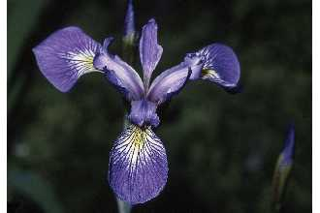
Iris Sample Data Set
Many of the exploratory data techniques are illustrated with the Iris Plant data set.
Can be obtained from the UCI Machine Learning Repository http://www.ics.uci.edu/~mlearn/MLRepository.html
Three flower types (classes):
Setosa
Virginica
Versicolour
Four attributes
Sepal width and length
Petal width and length

Slide 4
Summary Statistics
Summary statistics are quantities, such as the mean and standard deviation,
that capture various characteristics of a potentially large set of values with a
single number or a small set of numbers.
Summarized properties include frequency, location and spread

Slide 5
Frequencies and the Mode
The frequency of an attribute value is the percentage of time the value occurs in the data set
For example, given the attribute ‘gender’ and a representative population of people, the gender ‘female’ occurs about 50% of the time.
The mode of a an attribute is the most frequent attribute value

Slide 6
Percentiles
Median
a number p between 0 and 100, the pth percentile is a value x_{p} of x such that p% of the observed values of x are less than x_{p} .

Slide 7
Mean
Mean
mean is the most common measure of the location of a set of points.
attribute values of x for m objects.
mean is very sensitive to outliers

Slide 8
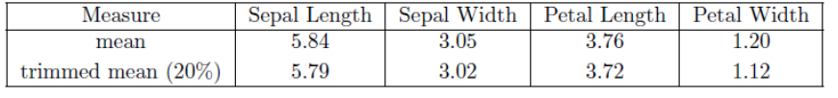
trimmed mean
trimmed mean
A percentage p between 0 and 100 is specified
top and bottom (p/2)% of the data is thrown out
mean is then calculated in the normal way.

Slide 9
Measures of Spread: Range and Variance
Range is the difference between the max and min
Variance or standard deviation is the most common measure of the spread of a set of points.
sensitive to outliers

Slide 10
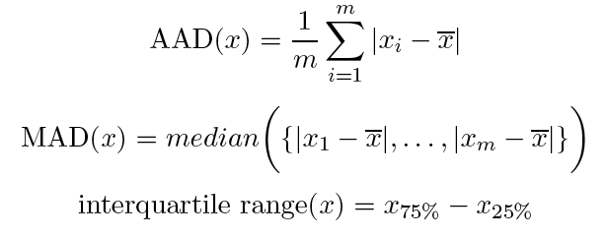
Measures of Spread: Range and Variance
Range is the difference between the max and min
Variance or standard deviation is the most common measure of the spread of a set of points.
sensitive to outliers
absolute average deviation (AAD)
median absolute deviation (MAD)

Slide 11
Multivariate Summary Statistics
if xi and xj are the ith and jth attributes, then
correlation matrix R

Slide 12
Visualization

Slide 13
Visualization
Visualization is the conversion of data into a visual format so that the characteristics of the data and the relationships among data items or attributes can be analyzed or reported
people can quickly absorb large amounts of visual information

Slide 14
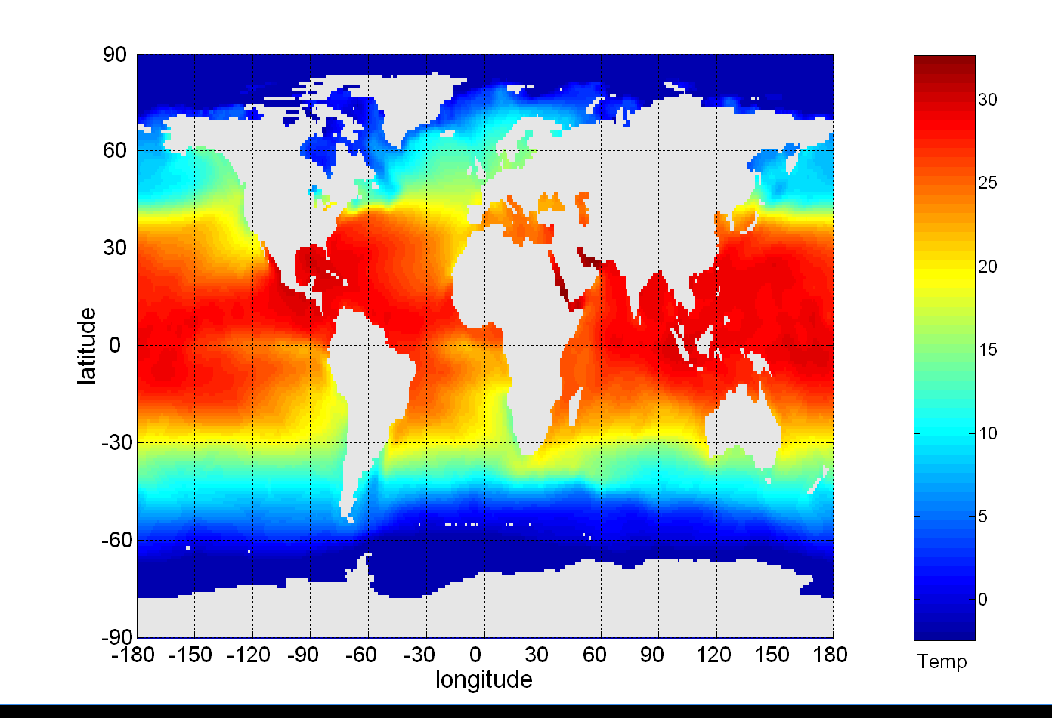
Visualization
Visualization is the conversion of data into a visual format so that the characteristics of the data and the relationships among data items or attributes can be analyzed or reported
people can quickly absorb large amounts of visual information
Sea Surface Temperature (SST) in degrees Celsius

Slide 15
Visualization Techniques: Histograms
Histogram
Usually shows the distribution of values of a single variable
Divide the values into bins and show a bar plot of the number of objects in each bin.
The height of each bar indicates the number of objects
Shape of histogram depends on the number of bins

Slide 16
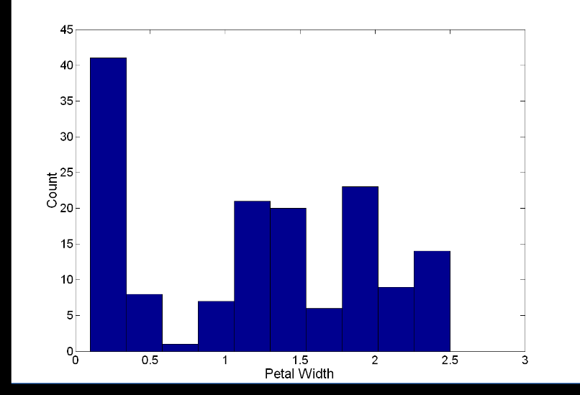
Visualization Techniques: Histograms
Histogram
Usually shows the distribution of values of a single variable
Divide the values into bins and show a bar plot of the number of objects in each bin.
The height of each bar indicates the number of objects
Shape of histogram depends on the number of bins
Example: Petal Width (10 and 20 bins, respectively)

Slide 17
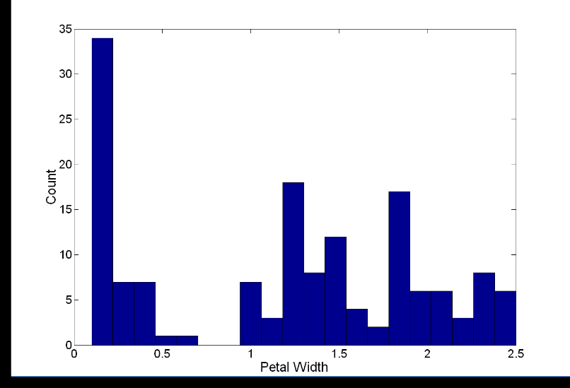
Visualization Techniques: Histograms
Histogram
Usually shows the distribution of values of a single variable
Divide the values into bins and show a bar plot of the number of objects in each bin.
The height of each bar indicates the number of objects
Shape of histogram depends on the number of bins
Example: Petal Width (10 and 20 bins, respectively)

Slide 18
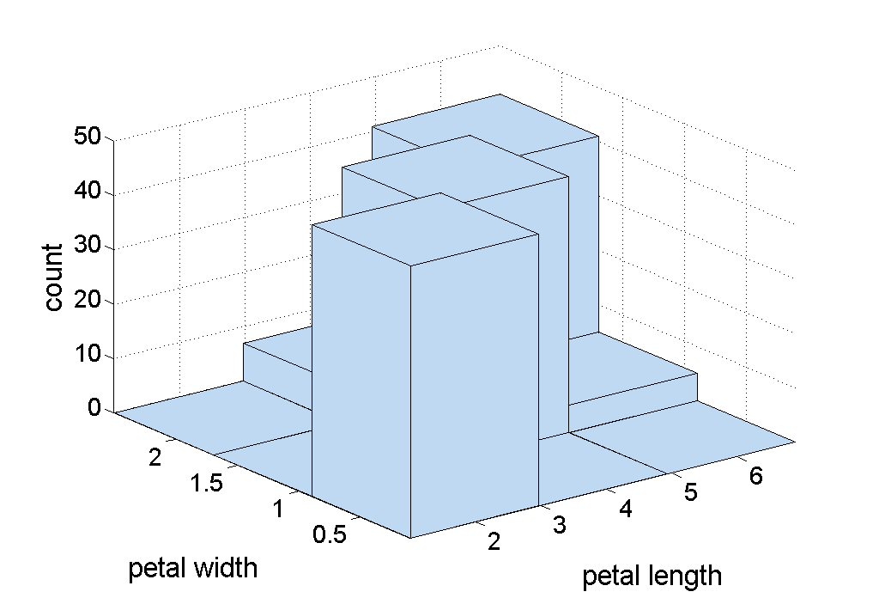
Two-Dimensional Histograms
Show the joint distribution of the values of two attributes
Example: petal width and petal length

Slide 19
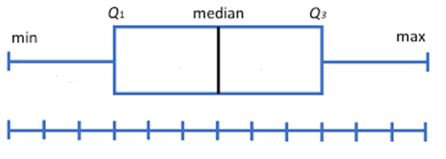
Visualization Techniques: Box Plots
Box Plots
Another way of displaying the distribution of data
Following figure shows the basic part of a box plot

Slide 20
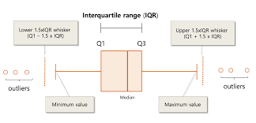

Slide 21
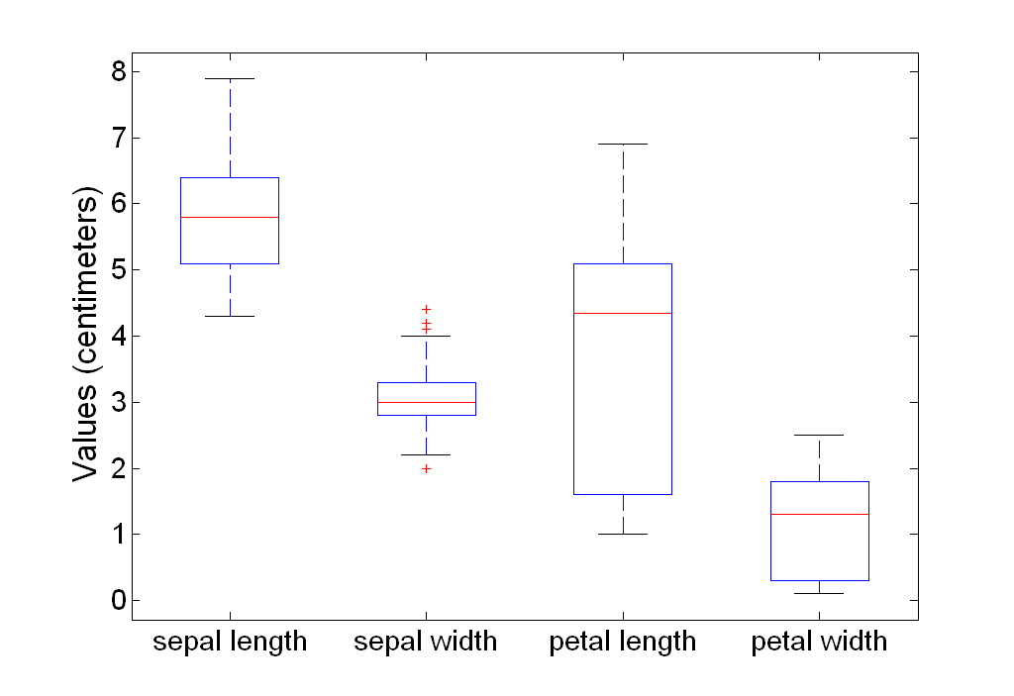
Visualization Techniques: Box Plots
Box plots can be used to compare attributes

Slide 22
Visualization Techniques: Box Plots
Box plots can also be used to compare how attributes vary between different classes of objects

Slide 23
Visualization Techniques: Scatter Plots
Scatter plots
Attributes values determine the position
Two-dimensional scatter plots most common, but can have three-dimensional scatter plots
Often additional attributes can be displayed by using the size, shape, and color of the markers that represent the objects
It is useful to have arrays of scatter plots can compactly summarize the relationships of several pairs of attributes

Slide 24
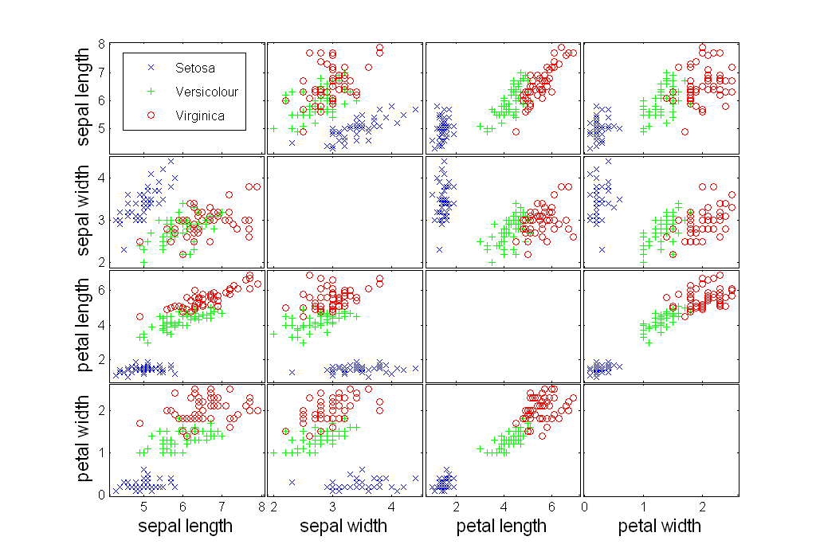
Visualization Techniques: Scatter Plots

Slide 25
Visualization Techniques: Matrix Plots
Matrix plots
Can plot the data matrix
This can be useful when objects are sorted according to class
Typically, the attributes are normalized to prevent one attribute from dominating the plot
Plots of similarity or distance matrices can also be useful for visualizing the relationships between objects

Slide 26
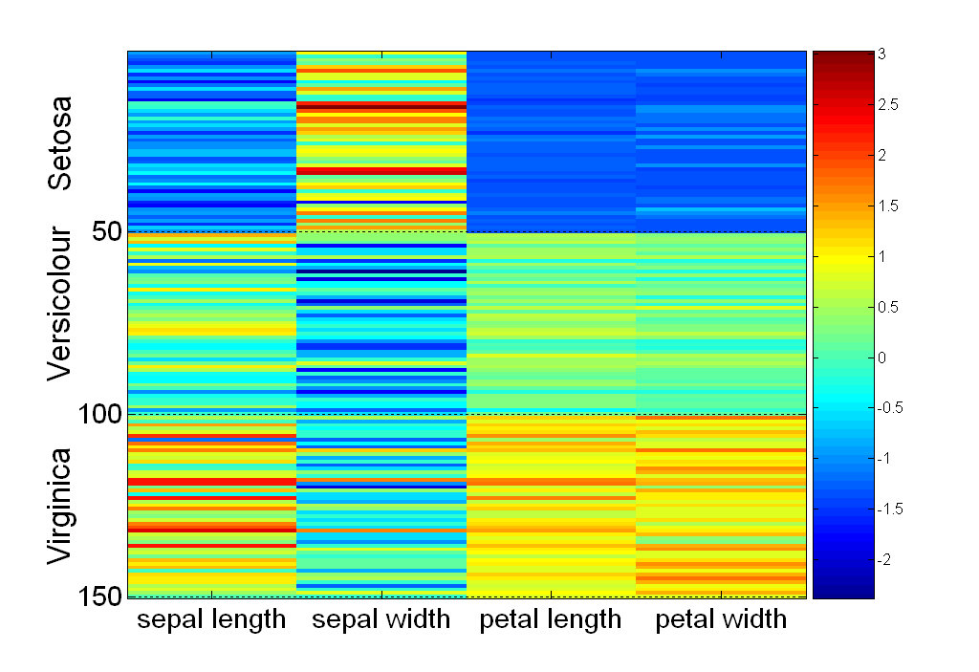
Visualization Techniques: Matrix Plots

Slide 27
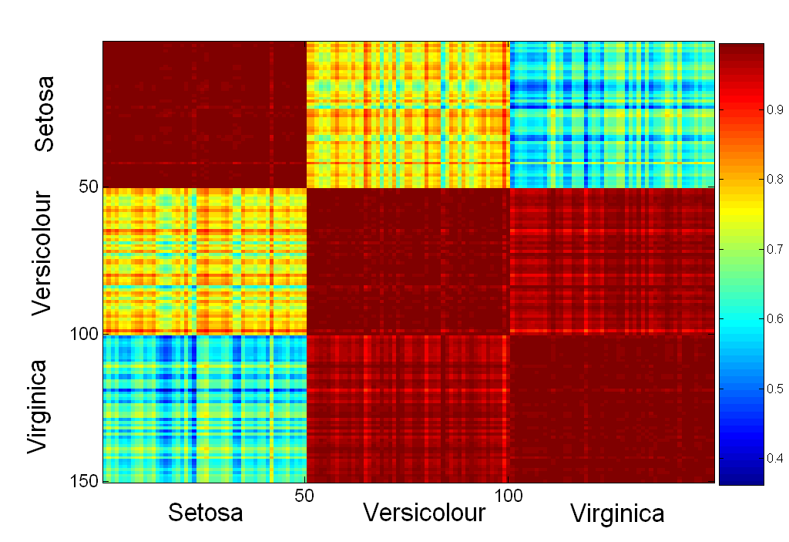
Visualization Techniques: Matrix Plots

